Slide 1
Community First: Using ChatGPT to Build Strong Open Source Communities
Jonas Rosland (he/him)
Head of Open Source Community Management
Oct 17, 2023
@jonasrosland

Slide 2
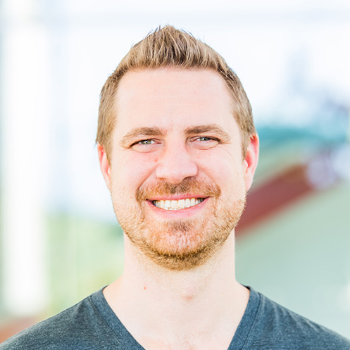
Whoami?
Head of Open Source Community Management @ VMware
Executive Director @ Hit Save!, a non-profit focused on video game history and preservation
Father of a wonderful daughter
Software and hardware tinkerer
Aspiring project finisher
@jonasrosland

Slide 3
AI at VMware
Our Marketing AI Council is a cross-functional team dedicated to educating and empowering VMware marketers to use genAI tools responsibly and effectively. We partner closely with VMware's corporate AI council run by our CTO.
@jonasrosland

Slide 4
AI WILL TAKE MY JOB AWAY!
@jonasrosland

Slide 5
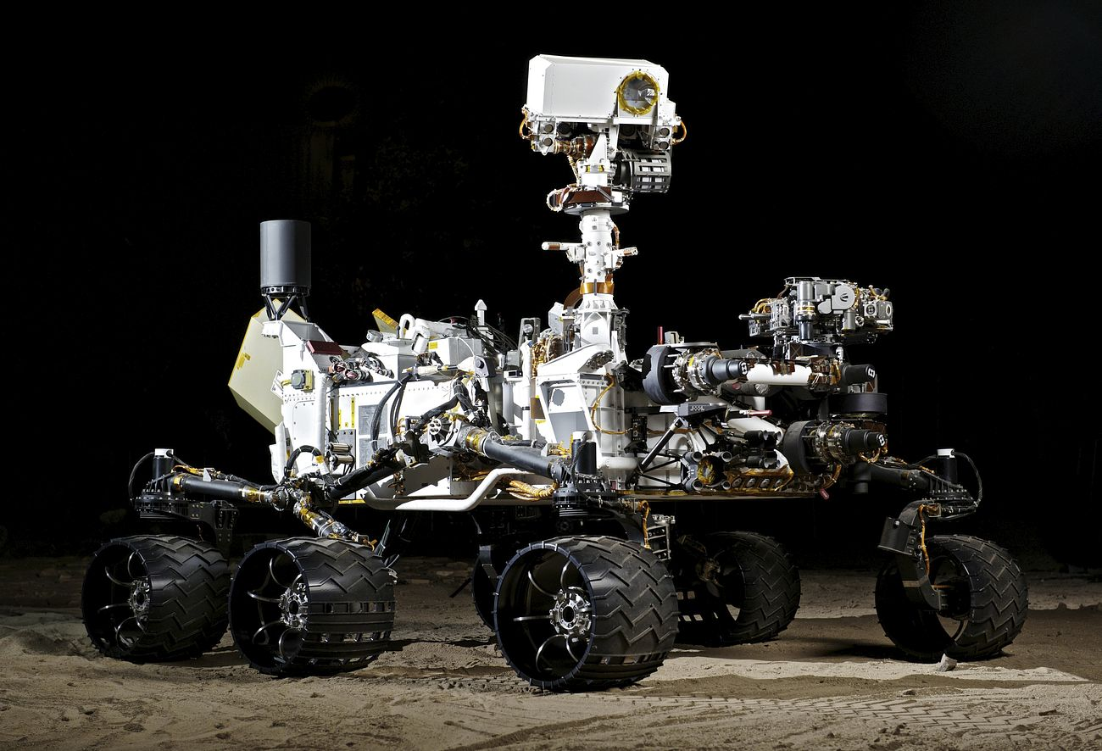
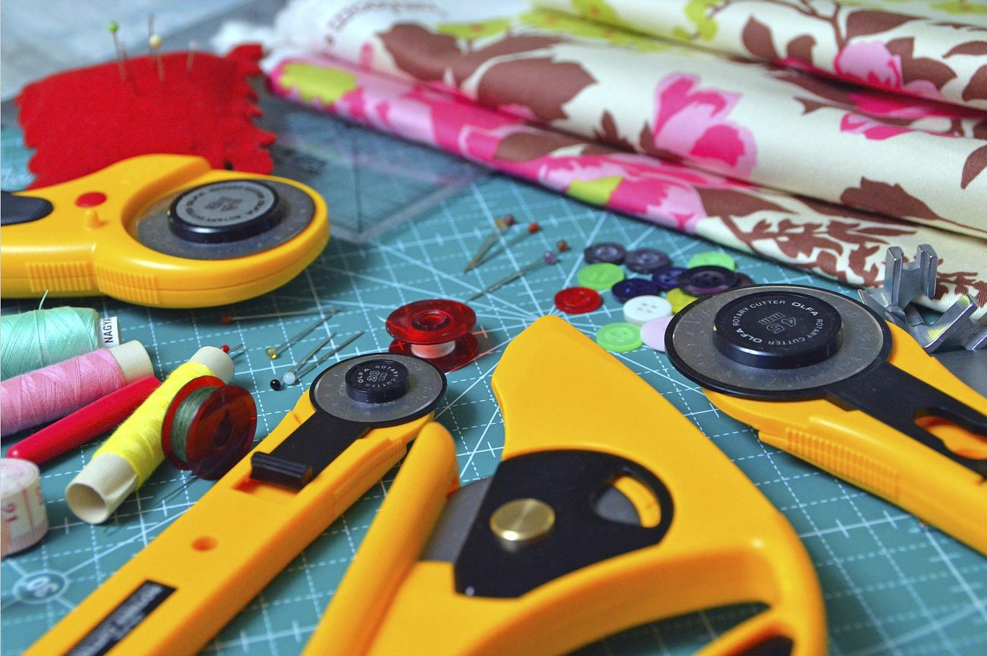
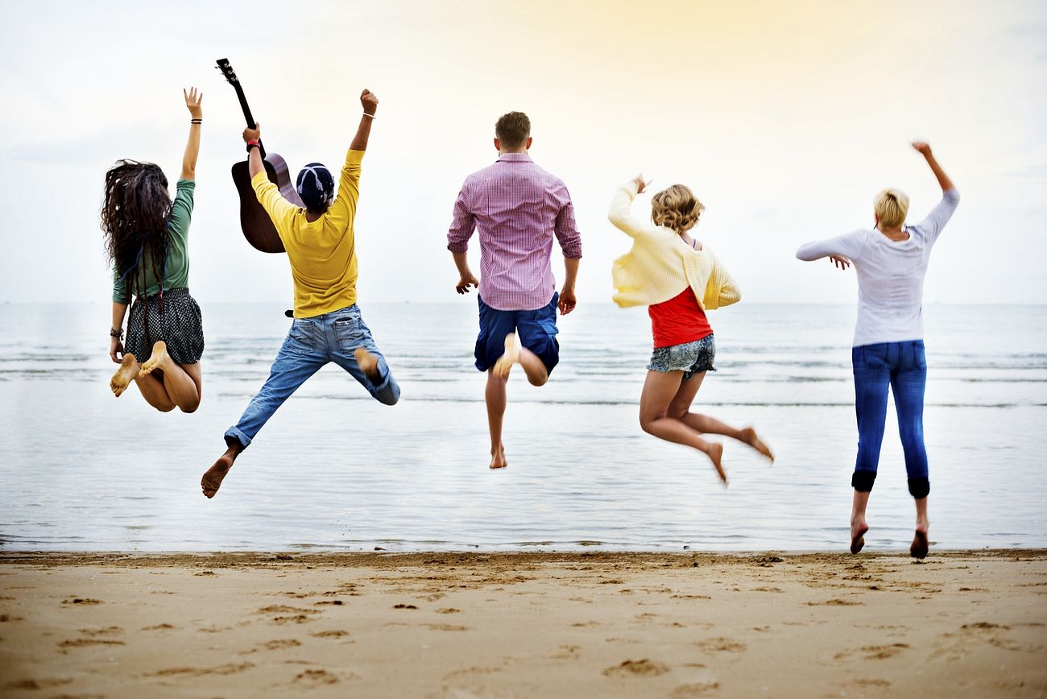
Yes, but … Think of the possibilities!
Automate the things that are time consuming
Create things that weren’t possible before
Have more time for the fun stuff
@jonasrosland

Slide 6
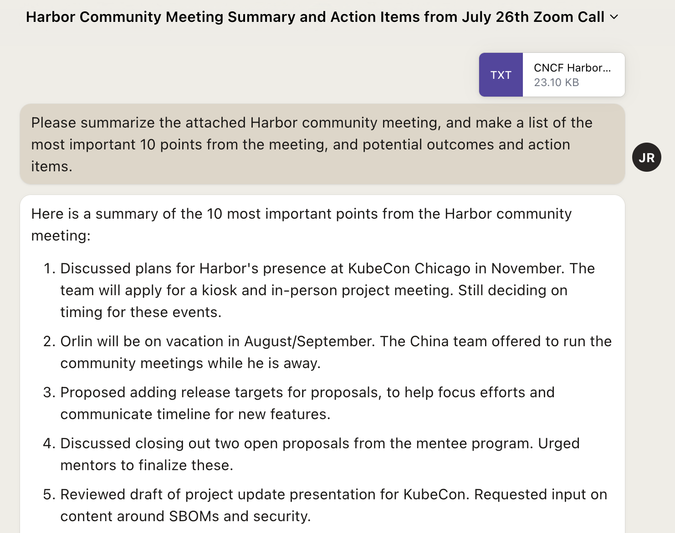
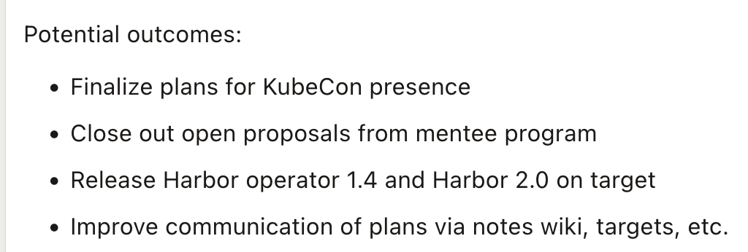
Time consuming stuff - Part 1
Automatic meeting note taking and summarization to improve information sharing
@jonasrosland

Slide 7
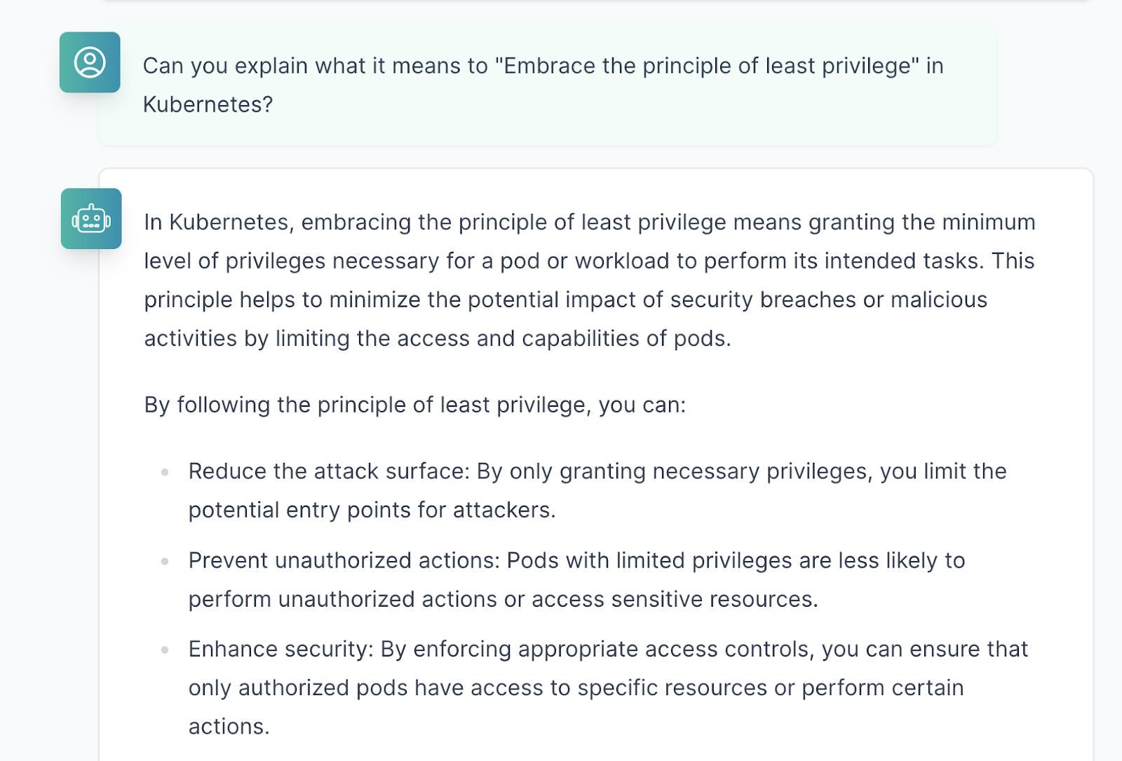
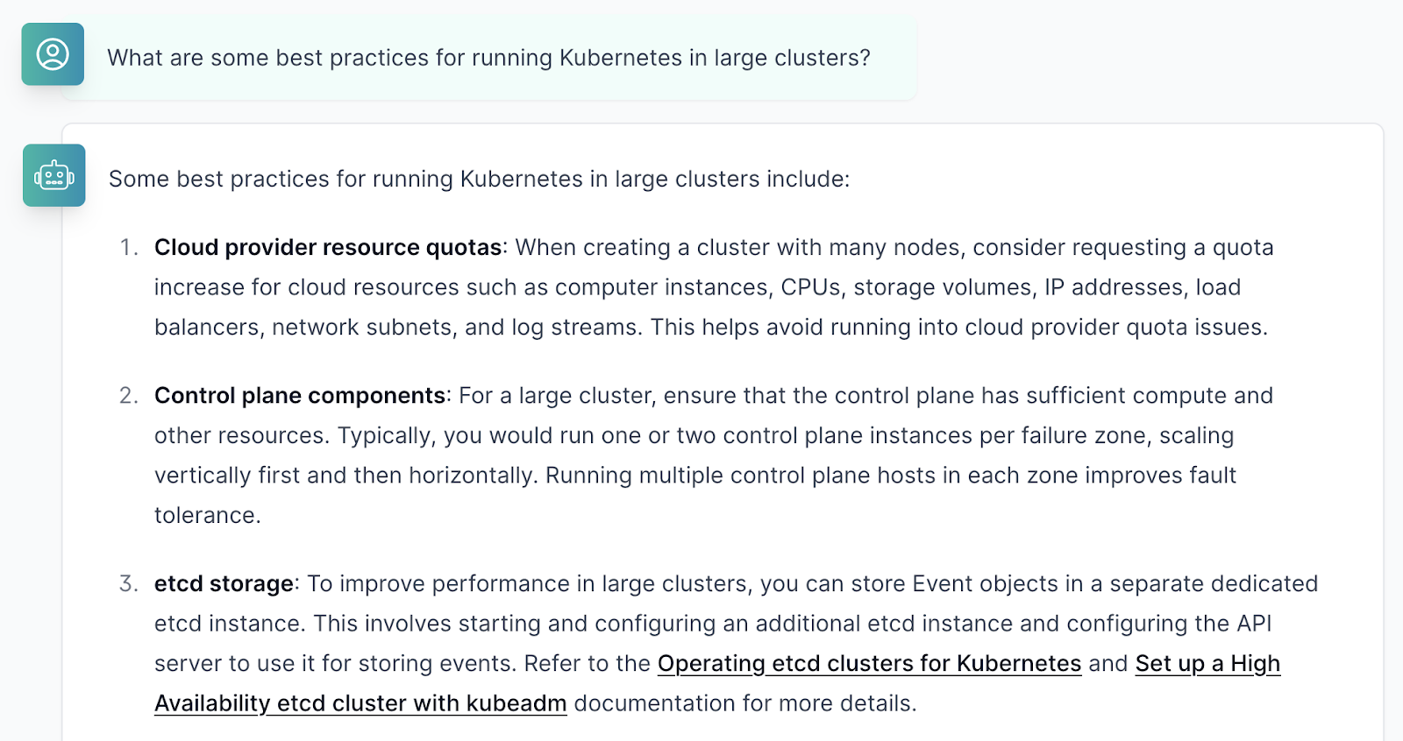
Time consuming stuff - Part 2
Chatbots to handle frequently asked questions & common requests to ease support burden
@jonasrosland

Slide 8
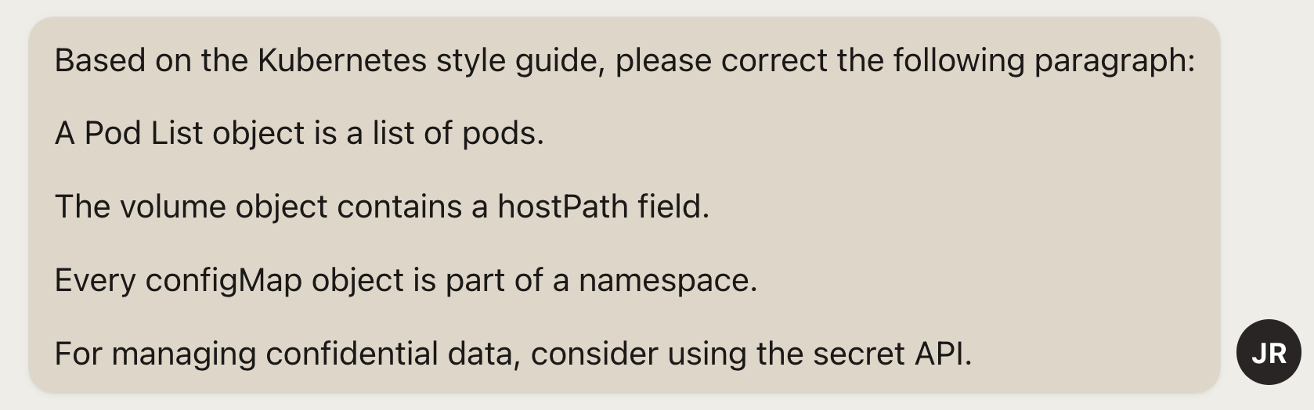
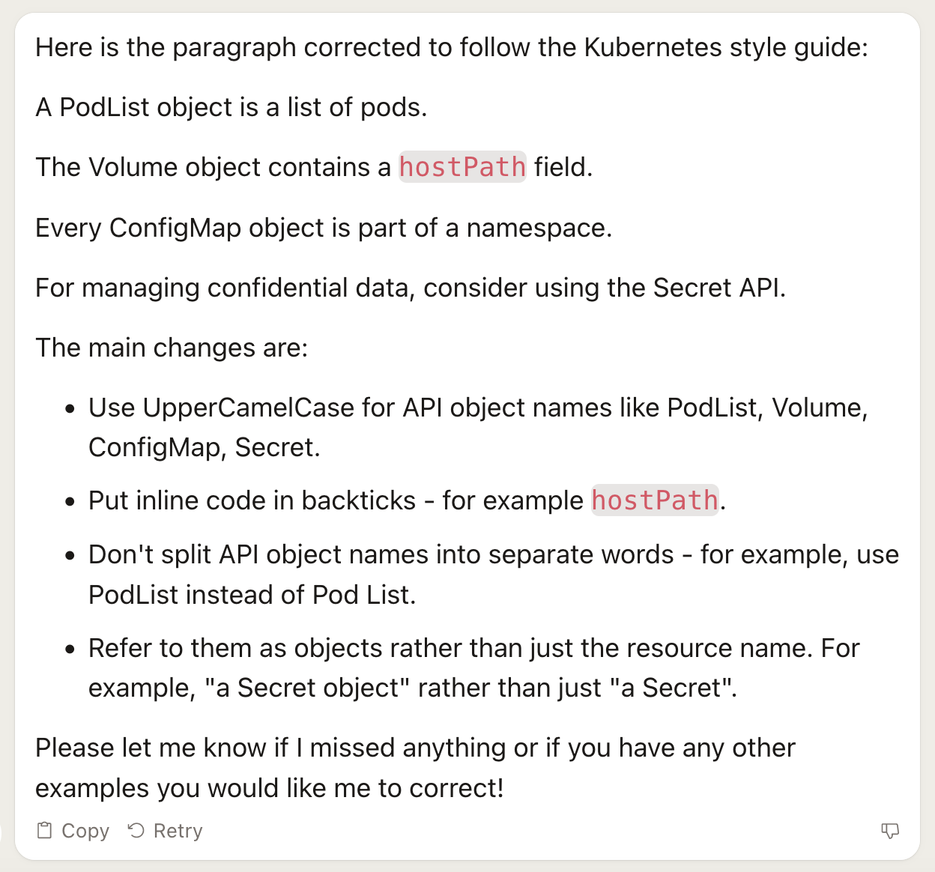
Time consuming stuff - Part 3
Correcting grammar and adhere to documentation style guides
@jonasrosland

Slide 9
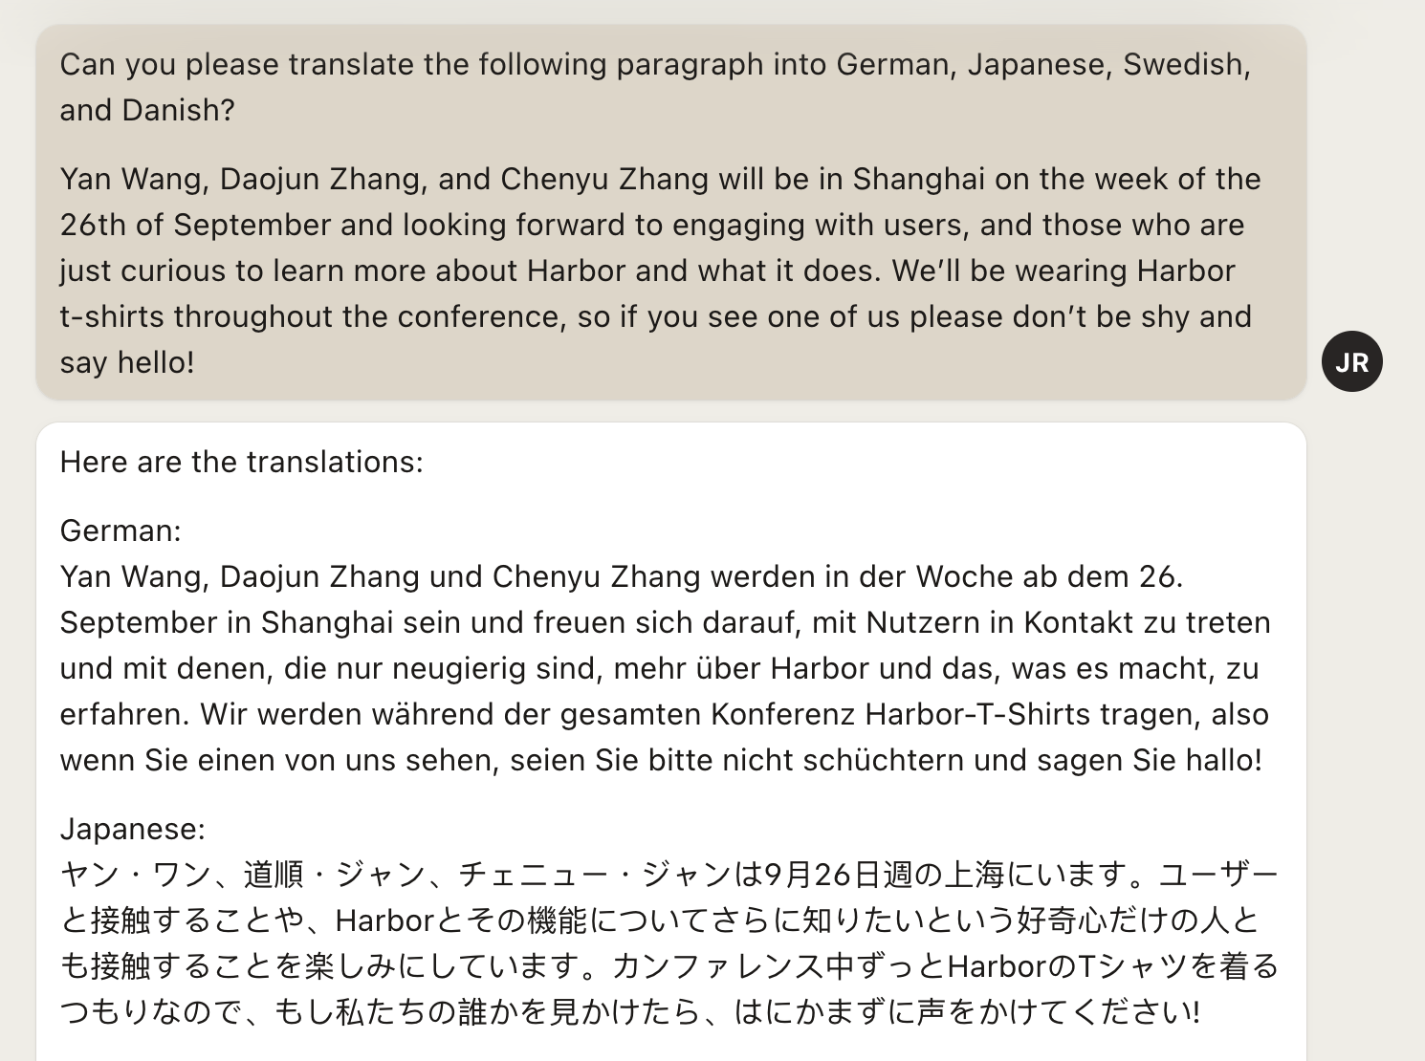
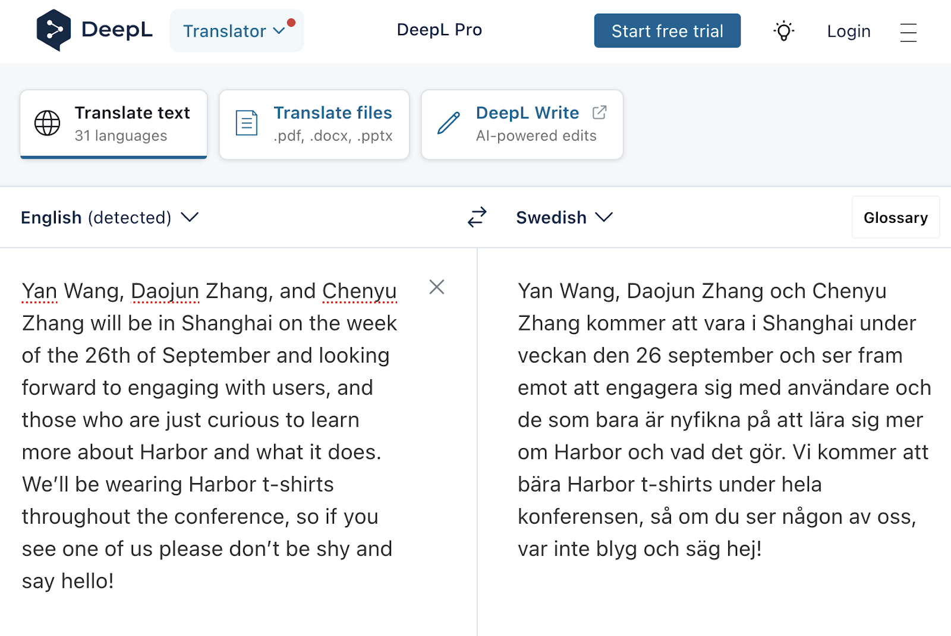
Create new and useful content - Part 1
Translated communications going out to community members in their native language
@jonasrosland

Slide 10
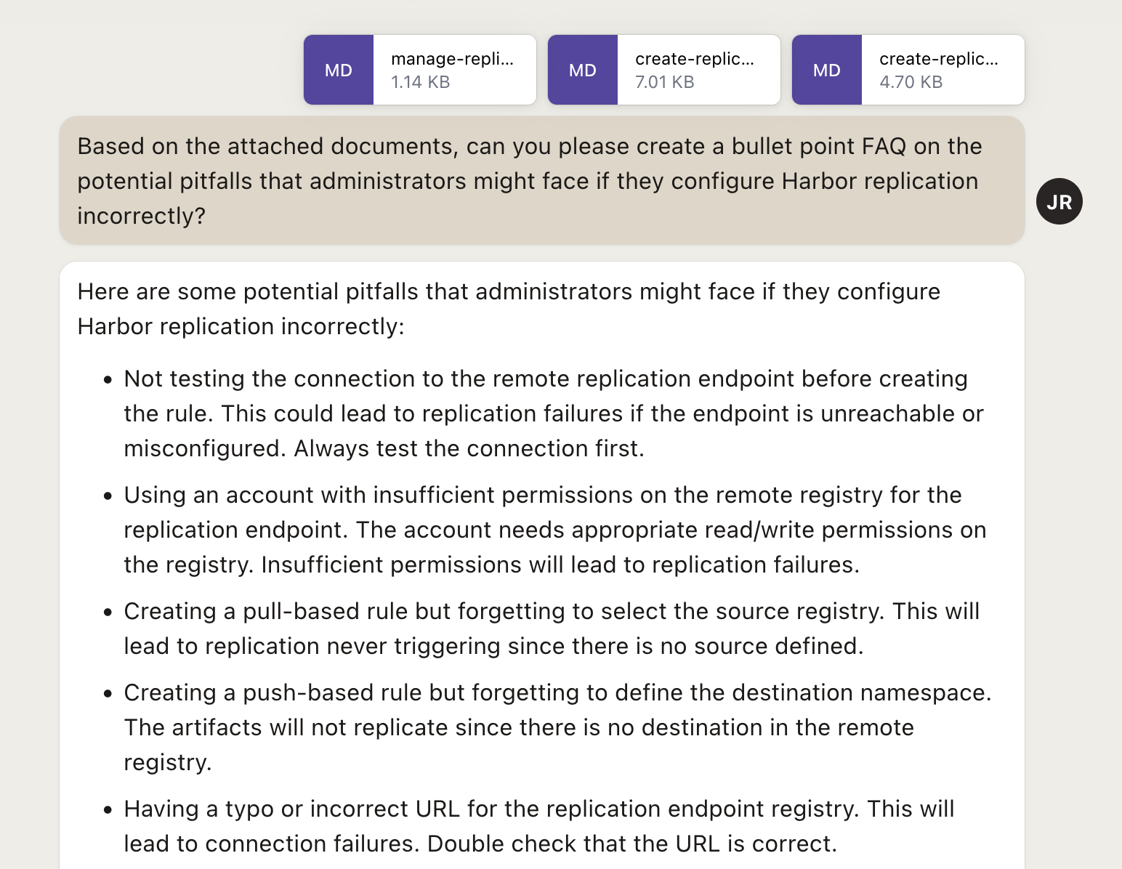
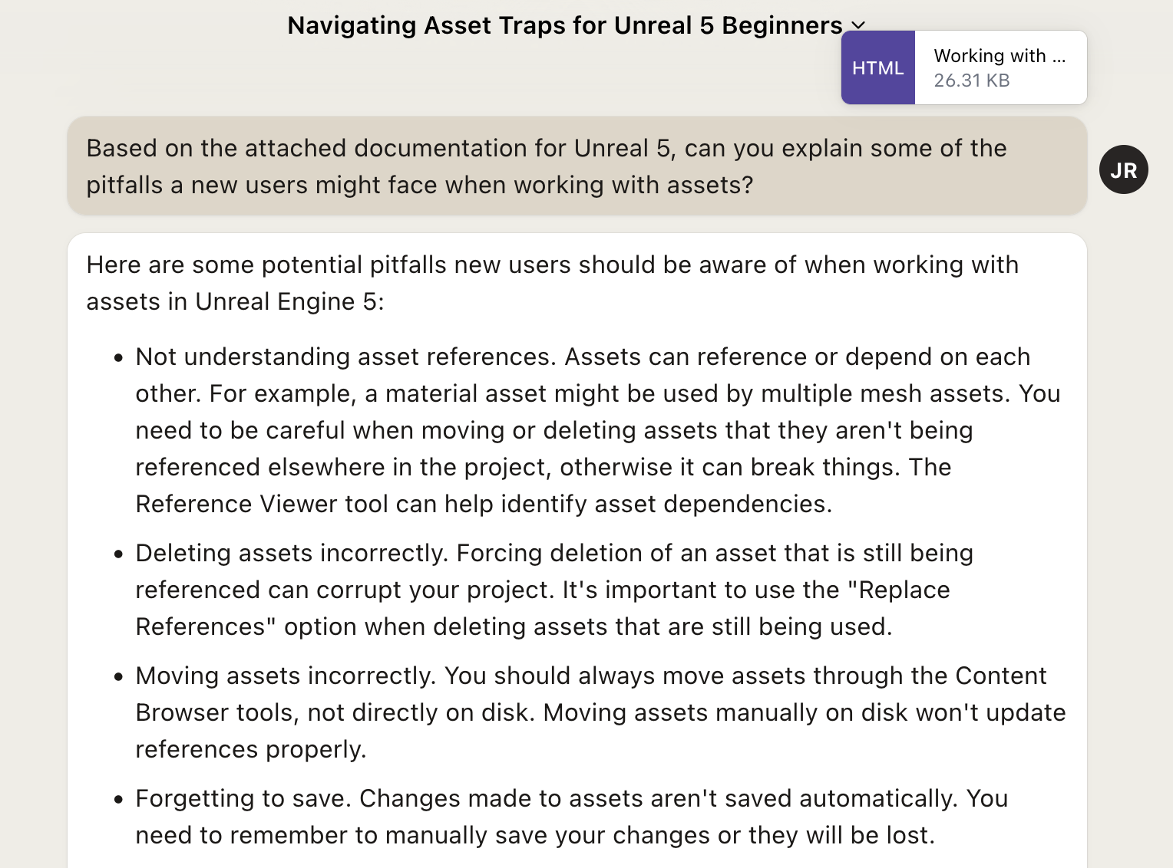
Create new and useful content - Part 2
Create FAQs based on the current docs
@jonasrosland

Slide 11
Live demo time!
@jonasrosland

Slide 12
Have more time for the fun stuff
Using these tools can free up time in your day that you can spend on working on other tasks
OR you can actually finish that chapter of the book you started yesterday
OR you can play another quest in the latest video game
OR you can spend time with family, kids, and friends
The main point of this talk is that generative AI has the possibility of giving you more of the most important non-renewable asset you have in your life:
TIME
@jonasrosland

Slide 13
Thank you!
@jonasrosland
claude.ai
docsbot.ai
writer.com
jasper.ai
fireflies.ai
www.deepl.com
Stable Diffusion installer: lykos.ai
@jonasrosland

